Slide 1


Doxing
Publishing private or identifying information about the target without their consent.

Slide 2

Impersonation
Creating fake profiles to impersonate the target and post damaging content or send harmful messages
ARS 13-2316 Computer Tampering
A person who acts without authority or who exceeds authorization of use commits computer tampering by:
5. Recklessly using a computer, computer system or network to engage in a scheme or course of conduct that is directed at another person and that seriously alarms, torments, threatens or terrorizes the person.
The full statute can be found - 13-2316 - Computer tampering; venue; forfeiture; classification (azleg.gov)

Slide 3
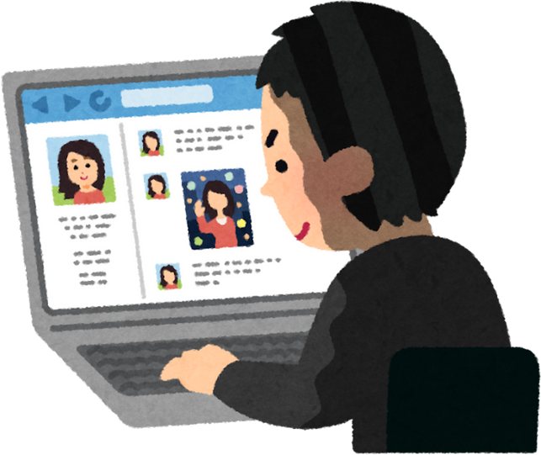
Cyberstalking
Continuously monitoring, following, and harassing the target online, sometimes across multiple platforms.
Law: ARS 13-2923 Stalking
A person commits stalking if the person intentionally or knowingly engages in a course of conduct that is directed toward another person and if that conduct causes the victim to suffer emotional distress or reasonably fear that the victim's property will be damaged or destroyed or physically injured.

Slide 4

Outing
Sharing the target’s private or embarrassing information, secrets, or images online.

Slide 5

Exclusion
Deliberately excluding the target from online groups, forums, or activities.

Slide 6

Trolling
Posting inflammatory, off-topic, or provocative messages to elicit emotional responses and disrupt conversations.

Slide 7
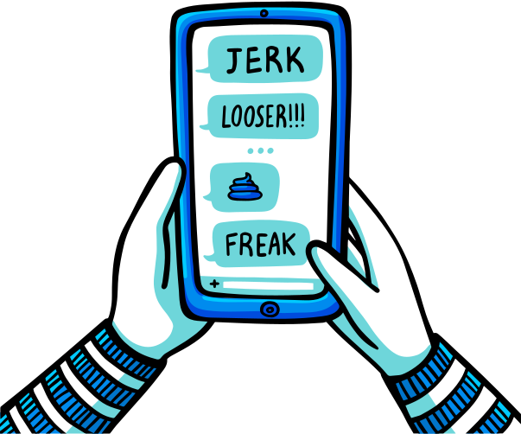
Flaming
Engaging in online arguments with the intent to upset and provoke the target through personal attacks.

Slide 8
Cyber threats
ARS 13-2916 Use of an Electronic Device to Terrify
It is unlawful for a person to knowingly terrify, intimidate, threaten or harass a specific person or persons by doing any of the following:
1. Directing any obscene, lewd or profane language or suggesting any lewd or lascivious act to the person in an electronic communication.
2. Threatening to inflict physical harm on any person or to property in any electronic communication.
3. Otherwise disturbing by repeated anonymous, unwanted or unsolicited electronic communications the peace, quiet or right of privacy of the person at the place where the communications were received.
4. Without the person's consent and for the purpose of imminently causing the person unwanted physical contact, injury or harassment by a third party, use an electronic communication device to electronically distribute, publish, email, hyperlink or make available for downloading the person's personal identifying information, including a digital image of the person, and the use does in fact incite or produce that unwanted physical contact, injury or harassment. This paragraph also applies to a person who intends to terrify, intimidate, threaten or harass an immediate family member of the person whose personal identifying information is used.
Sending threatening messages or making threats of physical harm or violence.

Slide 9

Spreading Rumors
Disseminating false information, gossip, or malicious rumors to damage the target’s reputation.

Slide 10

Photoshopping
Altering photos of the target to embarrass or humiliate them.

Slide 11

Hate Speech
Using derogatory language or slurs based on race, gender, sexuality, religion, or other characteristics to demean the target.

Slide 12

Bashing
Using the internet to make contact and commit direct verbal or visual attacks at any time.

Slide 13

Cyberbaiting
Provoking the target into an emotional response, then capturing and sharing that response to further humiliate them.

Slide 14

Catfishing
Creating a fake identity to deceive the target, often to form a deceptive relationship that can be later used against them.

Slide 15
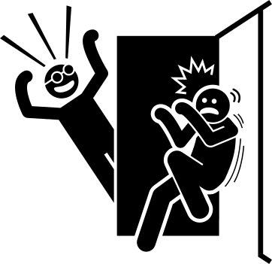
Pranking
Setting up elaborate hoaxes or pranks that embarrass or scare the target, often involving fake emergencies or threats.

Slide 16

Cyber Blackmail
Threatening to release private or embarrassing information unless the target complies with certain demands.

Slide 17

Cyber Mob Attacks
Organizing or inciting a group to collectively harass, intimidate, or attack the target online.
ARS 13-2316 Computer Tampering
Recklessly using a computer, computer system or network to engage in a scheme or course of conduct that is directed at another person and that seriously alarms, torments, threatens or terrorizes the person.
The full statute can be found - 13-2316 - Computer tampering; venue; forfeiture; classification (azleg.gov)

Slide 18

Review Bombing
Coordinating negative reviews on the target’s business, work, or social media profiles to damage their reputation.

Slide 19

Deep Fakes
Replacing a person in an existing image or video with someone else’s likeness for entertainment or to misinform, commit fraud, or harass. This action could be against the law.
Law: ARS 13-2316 Computer Tampering
Tampering A person who acts without authority or who exceeds authorization of use commits computer tampering by:
Recklessly using a computer, computer system or network to engage in a scheme or course of conduct that is directed at another person and that seriously alarms, torments, threatens or terrorizes the person.
The full statute can be found - 13-2316 - Computer tampering; venue; forfeiture; classification (azleg.gov)

Slide 20

Harrassment
Repeatedly subjecting someone to aggressive pressure or intimidation. The behavior is unwanted and humiliates or intimidates an individual. Repeatedly sending offensive, rude, and insulting messages to the target.
Law: ARS 13-2921
A person commits harassment if the person knowingly and repeatedly commits an act or acts that harass another person or the person knowingly commits any one of the following acts in a manner that harasses.

Slide 21

Gaslighting
A form of psychological manipulation in which a person or group makes someone questions their own reality, memory, or perceptions.

Slide 22

Swatting
A dangerous prank or malicious act in which someone falsely reports a serious crime such as a hostage situation or an active shooter, to emergency services, causing a large armed police response to be dispatched to an unsuspecting person’s address.
ARS 13-2907.01 False Reporting
A person commits false reporting by initiating or circulating a report of a bombing, fire, offense or other emergency knowing that such report is false and intending:
1. That it will cause action of any sort by an official or volunteer agency organized to deal with emergencies; or
2. That it will place a person in fear of imminent serious physical injury; or
3. That it will prevent or interrupt the occupation of any building, room, place of assembly, public place or means of transportation.

Slide 23

Defamation
The act of making false and harmful statements about someone that damage their reputation

Slide 24

Mass Reporting
Coordinated effort by a group of individuals to file numerous complaints or reports against a specific user, post, or account on a social media platform or online service.

