Slide 1
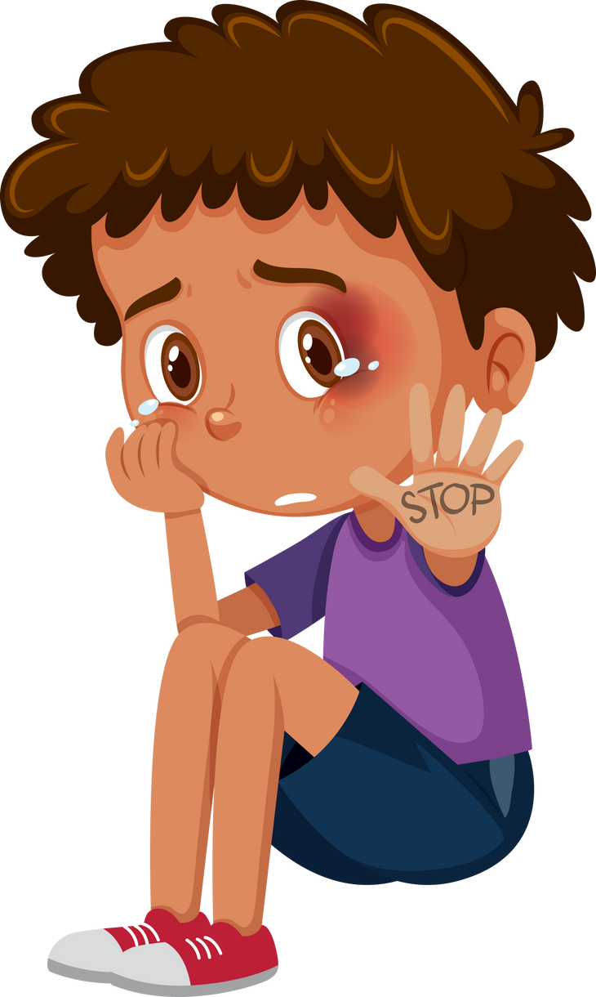
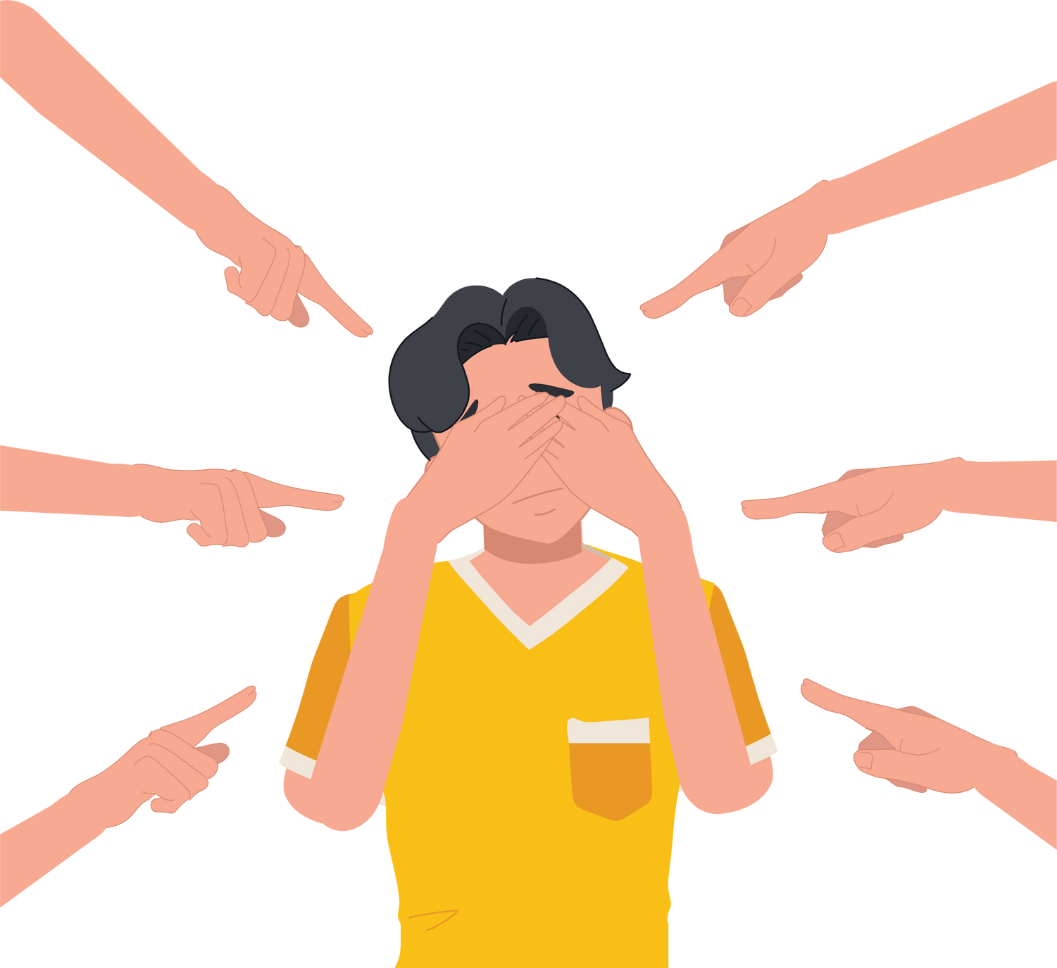
Physical harm: The person with bullying behavior is known to assault people or there is a fear they will assault anyone who tries to help.
Retaliation: There is a fear that the person with bullying behavior will target anyone who tries to stop them.
Increase the bullying: There is a fear that the target will be bullied more if someone tries to help.
Other Ideas: What other unsafe situations might there be?

