Slide 1
Classroom Wall
Scissors
Crayons
Bathroom Walls
Cafeteria
Classroom Toys
Classroom Books
School Desks
School Papers

Slide 2
Pencils
Student Backpack
Bulletin Board
Student Jacket
Playground
Game Balls
Art Work
School Signs
Sidewalks

Slide 3
Toilets
Sinks
Doors
Trees
Plants
Trashcans
Water Fountains
Computers
White Boards

Slide 4
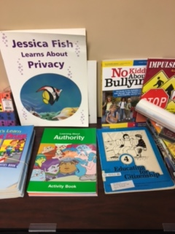
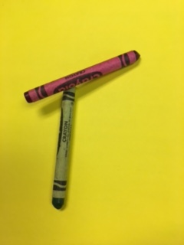
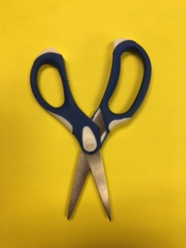
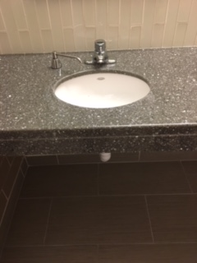
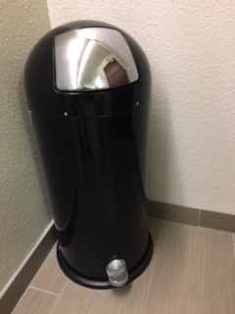
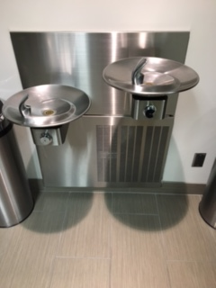
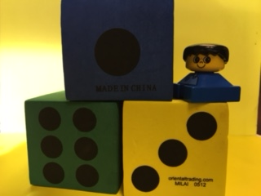
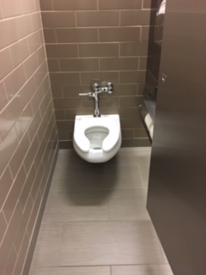
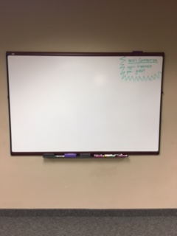

Slide 5
I will follow rules for taking care of ___________________.

Slide 6
Write a sentence about following rules on respecting property. Draw a picture of property you will show respect for.

