Slide 1
25% of youth report that they had requests by a caretaker for sexual activity as a reason for running away
https://www.nlchp.org/Alone_Without_A_Home
43% of youth that runaway report being beaten by a caretaker as the reason for running away.
https://www.nlchp.org/Alone_Without_A_Home
Each year an estimated 1.6 million children experience homelessness in relation to running away from home. Youth that run away from home do so for many reasons – including severe family conflict, parental abuse or neglect, family mental health issues and/or substance abuse.
https://www.nlchp.org/Alone_Without_A_Home
Every law in Arizona can be located in the Arizona Revised Statutes through the state legislature on the web or in printed form. The web address is: http://www.azleg.gov/arstitle/

Slide 2
Arizona does not have a specific statute for runaway, but would classify the act as an “incorrigible child” – Arizona Revised Statute 8-201(19)
Every law in Arizona can be located in the Arizona Revised Statutes through the state legislature on the web or in printed form. The web address is: http://www.azleg.gov/arstitle/
20% of youth had conflicts with their parents around their sexual orientation which caused them to leave
https://www.nlchp.org/Alone_Without_A_Home
It is against the law in Arizona for an adult or another juvenile to ‘harbor’ a runaway youth – this law is called, contributing to the delinquency of a minor; Arizona Revised Statute 13-3616
https://www.nlchp.org/Alone_Without_A_Home

Slide 3
1 in 6 of the 18,500 runaways reported to the National Center for Exploited and Missing Children in 2016 were likely to be sex trafficking victims
http://www.missingkids.org/cybertipline
If you are ever in a crisis and need to reach out to someone, you can text 741741 (24 hours a day, 365 days a year).
https://www.crisistextline.org/
If you suspect someone is a missing child and needs help you can call 1800-843-5678
The National Center for Missing and exploited Children
http://www.missingkids.org/LegalResources/Runaway
If you have run away from home, are not sure what to do, and need help, you can call 1-800-786-2929
https://www.1800runaway.org/#

Slide 4
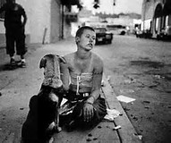
Images retrieved from: https://www.bing.com/images/search?view=detailV2&ccid=M2s6w5Hg&id=E98FBF366AF82504550A5485AAA8C2E51177063E&thid=OIP.M2s6w5HgsOhJv_ABDHPULQEsDK&q=Juvenile+Youth&simid=608004312385195943&selectedIndex=81&ajaxhist=0

Slide 5

Images retrieved from: https://www.bing.com/images/search?view=detailV2&ccid=M2s6w5Hg&id=E98FBF366AF82504550A5485AAA8C2E51177063E&thid=OIP.M2s6w5HgsOhJv_ABDHPULQEsDK&q=Juvenile+Youth&simid=608004312385195943&selectedIndex=81&ajaxhist=0

Slide 6

Images retrieved from: https://www.bing.com/images/search?view=detailV2&ccid=M2s6w5Hg&id=E98FBF366AF82504550A5485AAA8C2E51177063E&thid=OIP.M2s6w5HgsOhJv_ABDHPULQEsDK&q=Juvenile+Youth&simid=608004312385195943&selectedIndex=81&ajaxhist=0

Slide 7
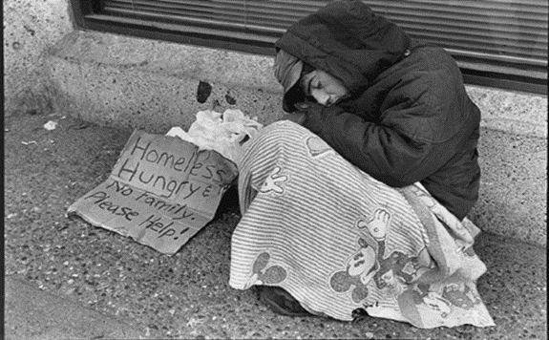
Images retrieved from: https://www.bing.com/images/search?view=detailV2&ccid=M2s6w5Hg&id=E98FBF366AF82504550A5485AAA8C2E51177063E&thid=OIP.M2s6w5HgsOhJv_ABDHPULQEsDK&q=Juvenile+Youth&simid=608004312385195943&selectedIndex=81&ajaxhist=0

Slide 8
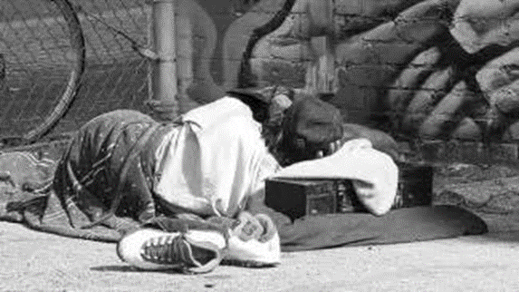
Images retrieved from: https://www.bing.com/images/search?view=detailV2&ccid=M2s6w5Hg&id=E98FBF366AF82504550A5485AAA8C2E51177063E&thid=OIP.M2s6w5HgsOhJv_ABDHPULQEsDK&q=Juvenile+Youth&simid=608004312385195943&selectedIndex=81&ajaxhist=0

Slide 9
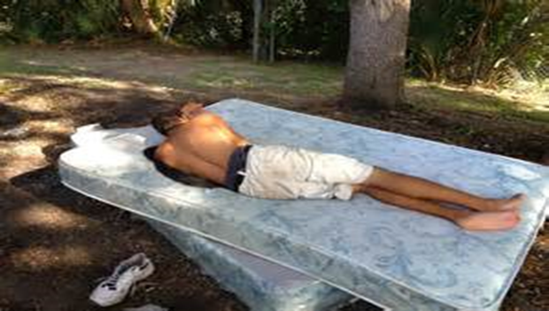
Images retrieved from: https://www.bing.com/images/search?view=detailV2&ccid=M2s6w5Hg&id=E98FBF366AF82504550A5485AAA8C2E51177063E&thid=OIP.M2s6w5HgsOhJv_ABDHPULQEsDK&q=Juvenile+Youth&simid=608004312385195943&selectedIndex=81&ajaxhist=0

