Slide 1
Reducing Aggressive Behaviors Through Conflict Resolution
Lesson 4: Conflict Resolution Style Scenario Cards

Slide 2

Scenario 1:
A high school club is planning a major fundraiser to raise money for an upcoming trip. The club president, Olivia, has carefully created a budget that limits spending to ensure the fundraiser meets its financial goals. During a meeting, several club members suggest spending more money on advertising and decorations to attract more donors, believing that this will increase profits, even though it would exceed the budget.
Task for the Groups
As a group, decide which conflict resolution style (competing, collaborating, compromising, avoiding, or accommodating would be most effective for Olivia and the club in this situation. Discuss why your chosen style is appropriate, and what the potential outcomes of using that style could be. Be ready to present and explain your reasoning.
Olivia is worried that overspending could put the entire fundraiser at risk, but the group is divided. Some members feel strongly about investing in better decorations, while others agree with Olivia's conservative approach. Tensions rise as they struggle to make a decision, and the clock is ticking with the fundraiser quickly approaching.

Slide 3

Scenario 2:
Two students, Mia and Ethan, are working together on a group project for their history class. Mia wants to create an elaborate presentation with visual aids and a detailed timeline. Ethan prefers a simpler approach that focuses more on written content and historical analysis. Both feel strongly about their ideas, and the project deadline is quickly approaching.
As the discussion becomes more heated, they realize they need to make a decision soon to ensure the project is completed on time. Ethan feels that his approach will lead to a better grade, while Mia believes her approach will make the project more engaging. Neither of them wants to compromise their ideas, and they’re unsure how to move forward without hurting their project.
Task for the Groups
As a group, decide which conflict resolution style (competing, collaborating, compromising, avoiding, or accommodating) Mia and Ethan should use to resolve their disagreement. Discuss why you believe your chosen style is the best for this situation, and consider the possible outcomes, Be prepared to present your group’s reasoning to the class

Slide 4

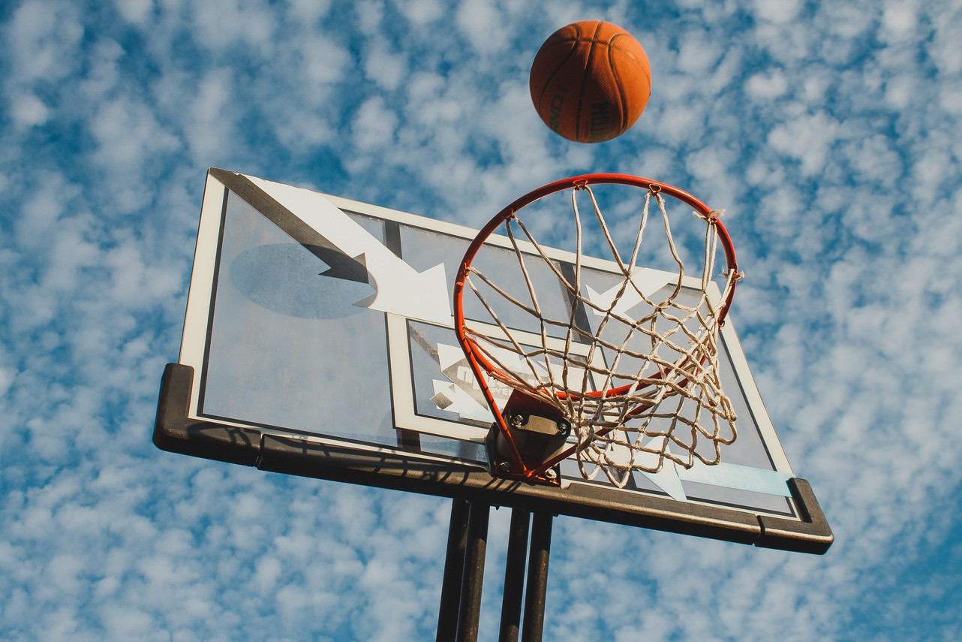
Scenario 3:
During lunch break, two students, Jordan and Chris, get into a heated argument over a basketball game from earlier in the day. Jordan accuses Chris of cheating, and Chris responds by making a sarcastic comment about Jordan’s skills. Tensions escalate quickly, and soon other students start gathering around, egging them on. Both Jordan and Chris are visibly angry, and it looks like the argument might turn into a physical fight. Jordan clenches his fists, and Chris takes a step closer, clearly ready to defend himself.
Task for the Groups
As a group, decide which conflict resolution style (competing, collaborating, compromising, avoiding, or accommodating) Jordan and Chris should use to resolve their issue and friendship. Discuss why you believe your chosen style is the best for this situation, and consider the possible outcomes, Be prepared to present your group’s reasoning to the class.
Jordan feels like he has to defend his reputation in front of the other students, but deep down, he knows that fighting will only get him suspended or charges pressed and ruin his reputation further. Chris, on the other hand, is feeling the pressure to prove himself.

Slide 5


Scenario 4:
A group of friends, including Emma, Jake, and Olivia, are planning a weekend outing. Emma wants to spend the day hiking at a nearby nature reserve because she loves the outdoors and wants to explore a new trail.
Jake, however, dislikes hiking and would rather spend the day at the mall and catch a movie. Olivia is stuck in the middle, enjoying both activities, but isn’t sure which plan to choose. As the weekend gets closer, the disagreement becomes more pronounced, with Emma and Jake both feeling strongly about their preferences and neither willing to back down.
Task for the Groups
As a group, decide which conflict resolution style (competing, collaborating, compromising, avoiding, or accommodating) Emma, Jake, and Olivia should use to have a fun weekend. Discuss why you believe your chosen style is the best for this situation, and consider the possible outcomes, Be prepared to present your group’s reasoning to the class
With the weekend approaching, the friends realize they need to figure out a plan quickly or risk not spending time together at all. Tensions are rising, and each friend is worried about being disappointed if their idea isn’t chosen.

Slide 6
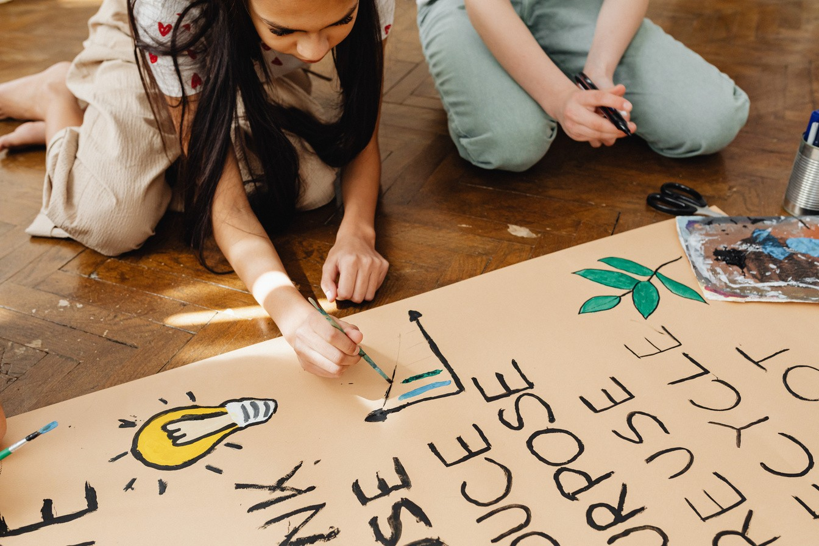
A group of students, including Maya, Carlos, and Ben, are in the drama club. They have been told to create a 10 minute skit to perform at the upcoming pep assembly.
Maya wants to do a short skit she wrote but Carlos wants to do a short skit he wrote. Neither will change their mind and the rest of the class is frustrated because they need time to practice before the pep assembl.
Scenario 5:
Task for the Groups
As a group, decide which conflict resolution style (competing, collaborating, compromising, avoiding, or accommodating) Maya, Carlos, and Ben should use to get their performance done. Discuss why you believe your chosen style is the best for this situation, and consider the possible outcomes, Be prepared to present your group’s reasoning to the class

