Slide 1



SUPERHERO?
WHO IS YOUR FAVORITE?

Slide 2
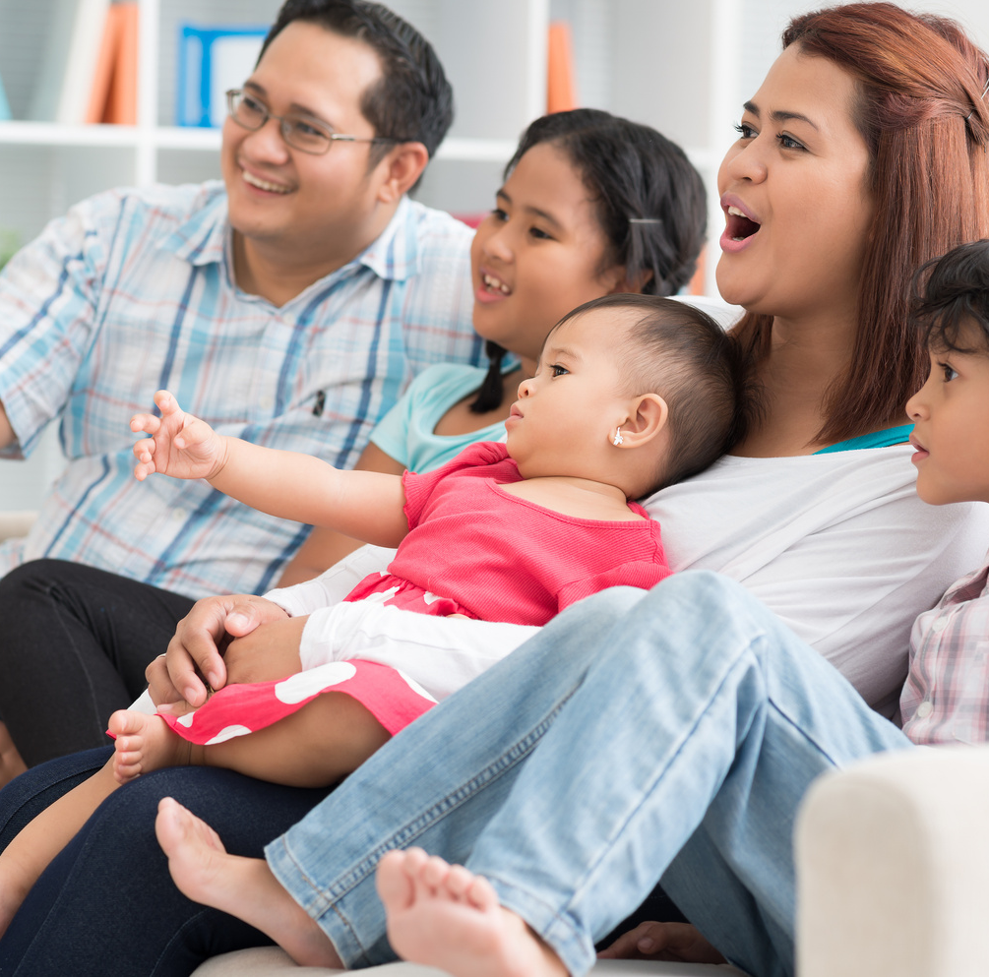
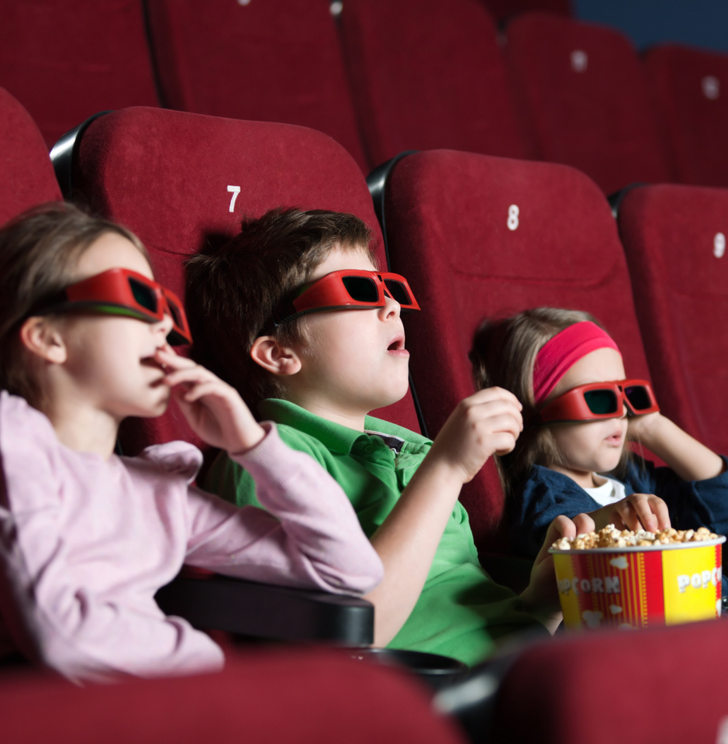

THEATERS
TV MOVIES
COMIC BOOKS

Slide 3
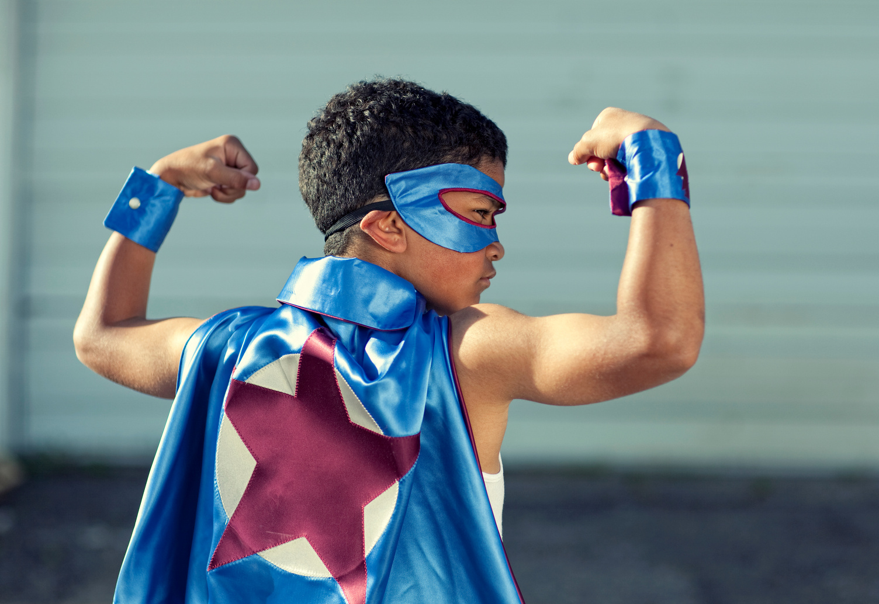




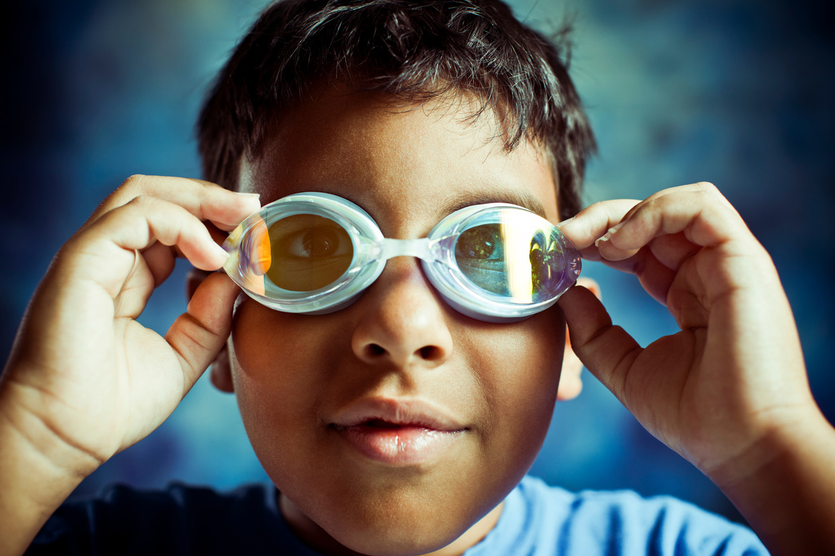
On my way!
I see!

Slide 4
Fairness
Helpfulness
A HERO IS SOMEONE WHO SHOWS COURAGE!
Honesty
Caring

Slide 5


WHAT QUALITIES DO THEY HAVE?
WHO IS YOUR REAL-LIFE HERO?

Slide 6
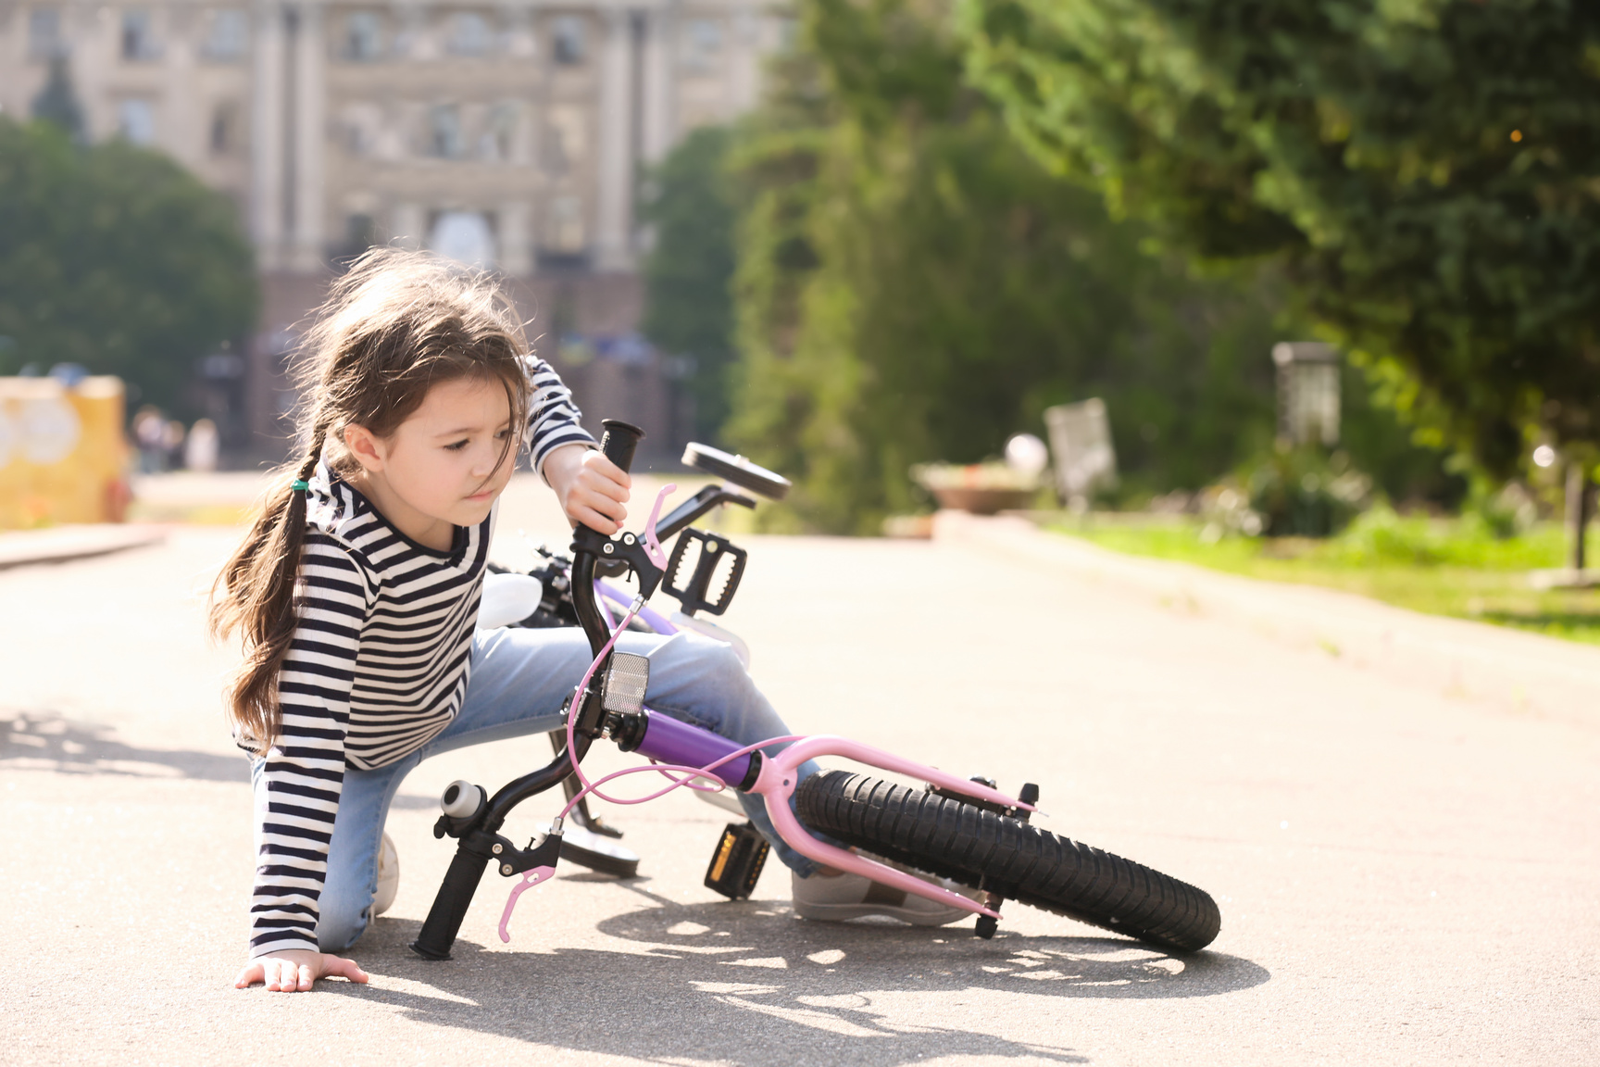

Slide 7
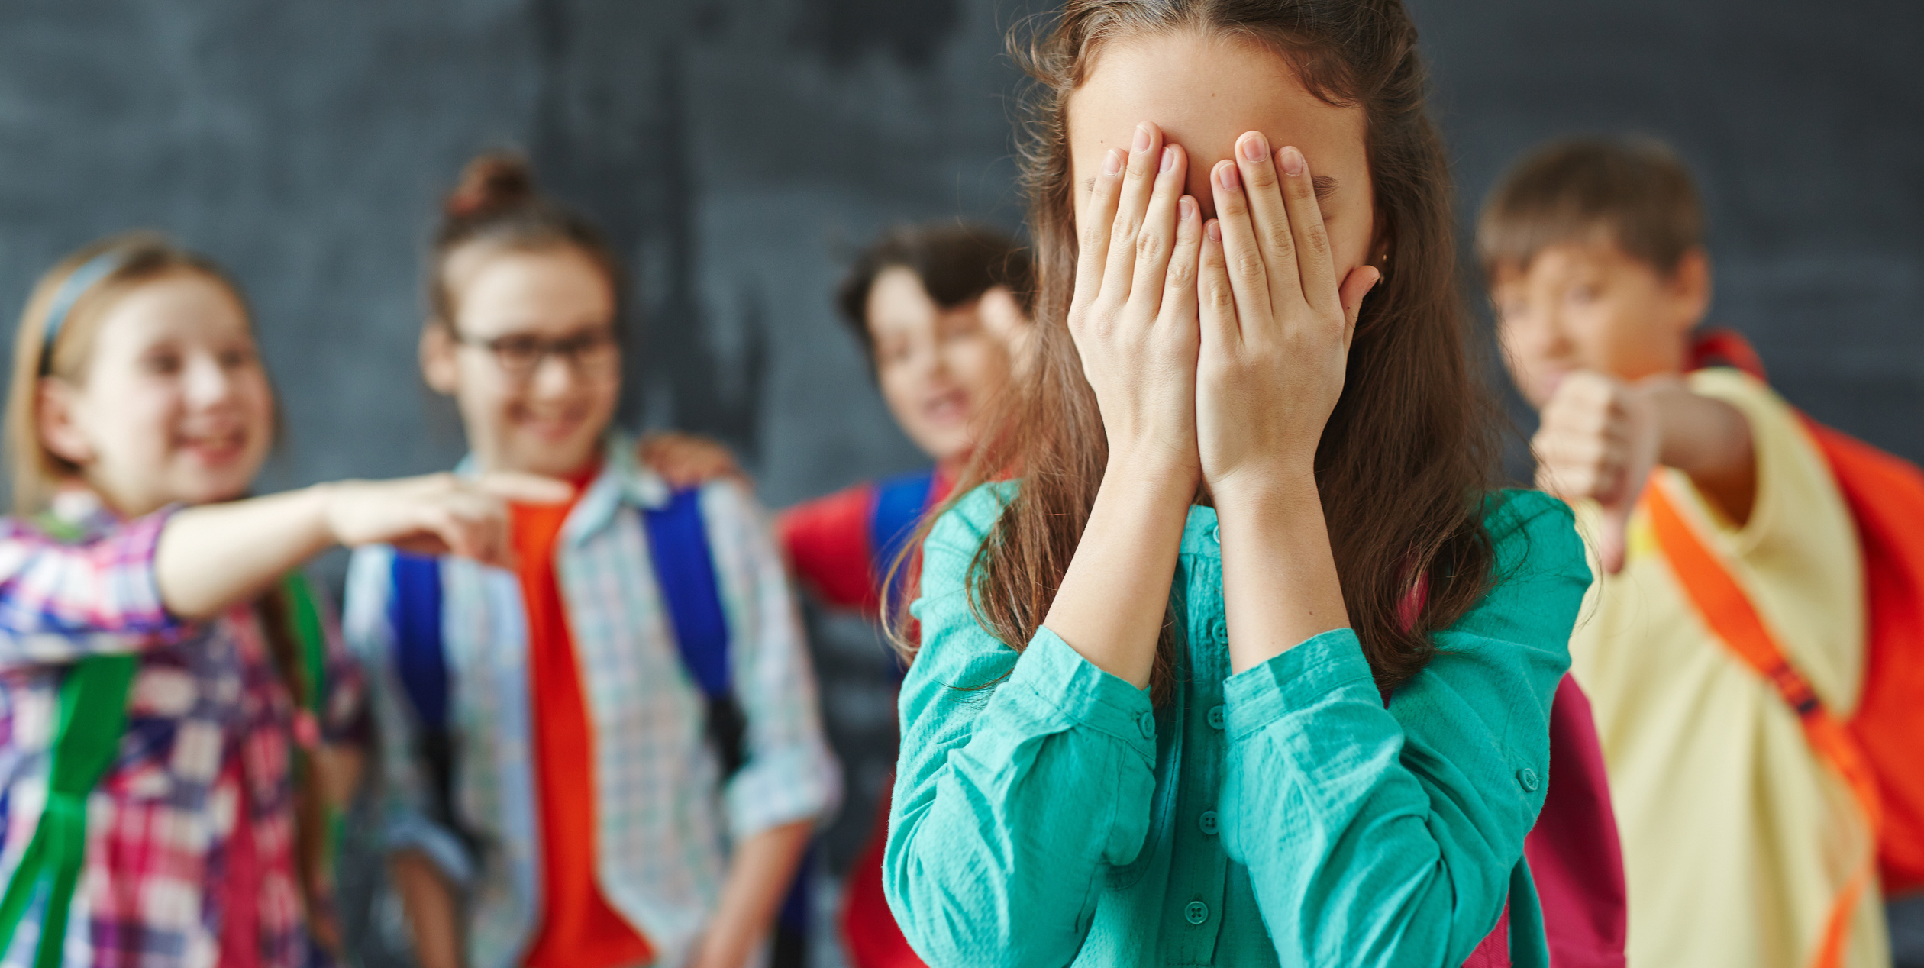

Slide 8
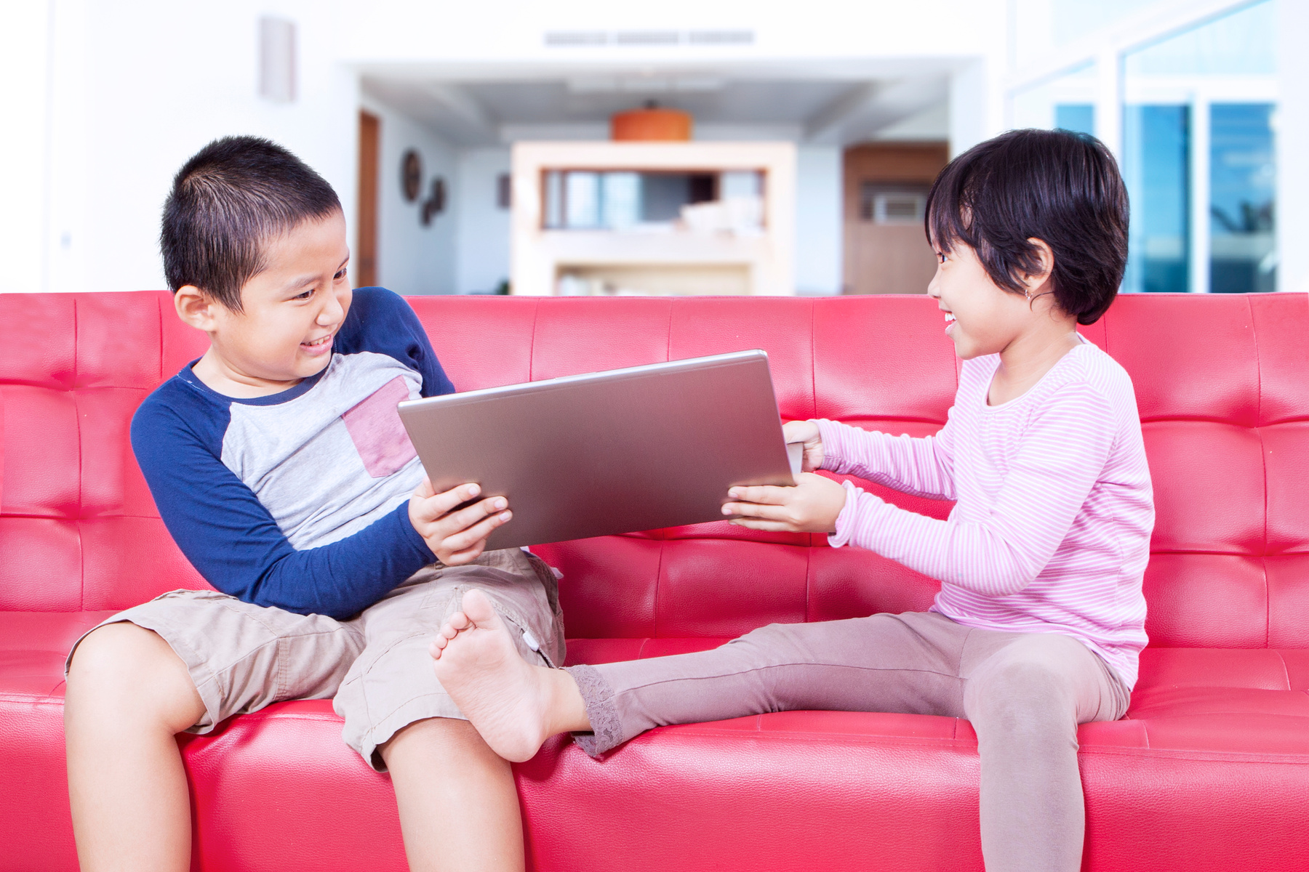

Slide 9
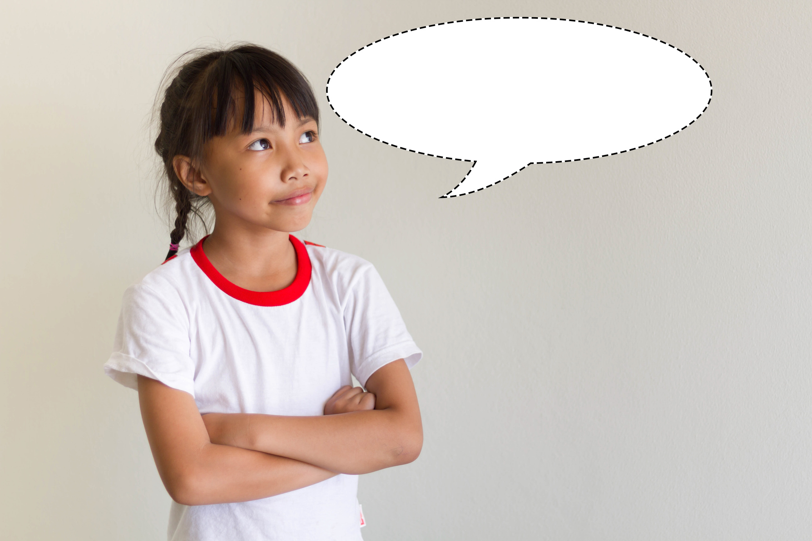
I know who took Jamie's bag with her homework. Should I report to the teacher what I saw?

Slide 10

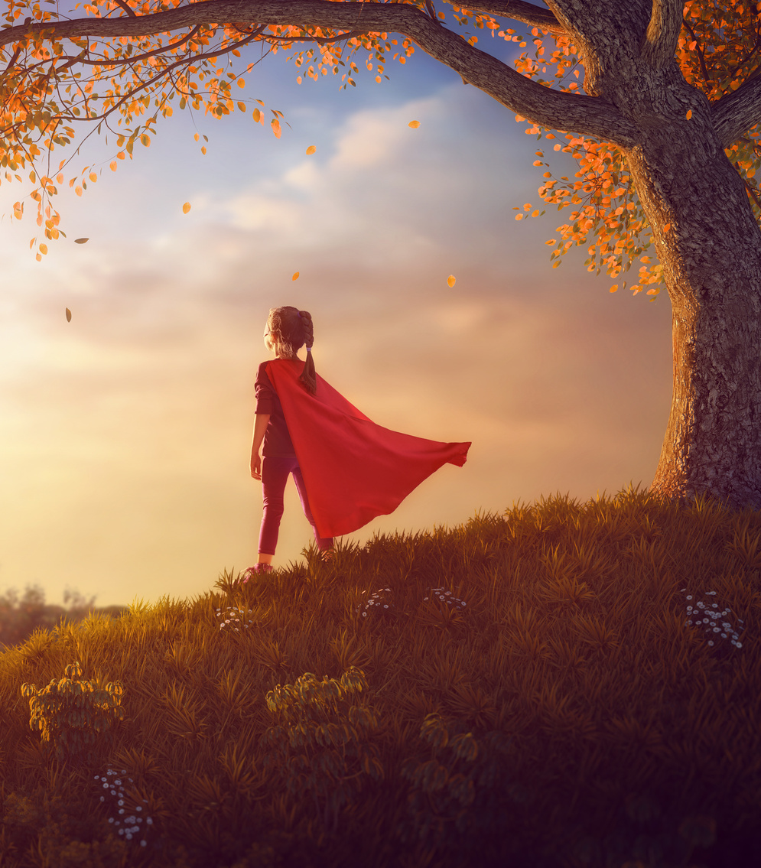
Helpful
Caring
Honest
Fair

Slide 11

I Can Be A Superhero Too!
I can be helpful.
I can be caring.
I can be honest.
I can be fair.
I can also be

