Slide 1
Stay seated if you have ever..
liked a post just because everyone else did
laughed at a comment online that you wouldn’t say out loud
kept scrolling instead of defending someone
deleted something because people reacted negatively
seen a comment section get out of control fast
joined a trend without really knowing why

Slide 2

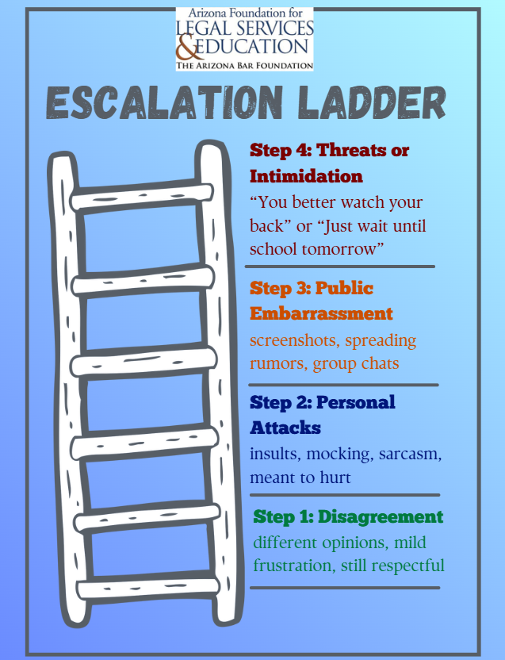

Slide 3
