Slide 1

How has life in the United States changed since 1776?
🤔

Slide 2
Time to Sort!
With your partner, sort the strips into one of the following categories where you think it belongs:
1700s 1800s 1900s 2000s

Slide 3

Get ready…
Use your fingers to show which century you think the law/right/event belongs…
1700s 1800s 1900s 2000s

Slide 4
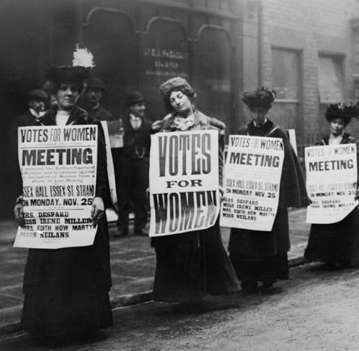
Women gained the right to vote with the 19th Amendment

Slide 5
Women gained the right to vote with the 19th Amendment
1920

Slide 6
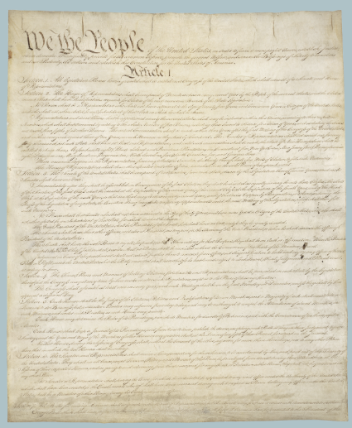
The U.S. Constitution was ratified, establishing the framework for American government

Slide 7
The U.S. Constitution was ratified, establishing the framework for American government
1788

Slide 8

The introduction of social media platforms increased freedom of expression and online civic engagement

Slide 9
The introduction of social media platforms increased freedom of expression and online civic engagement
2000s

Slide 10
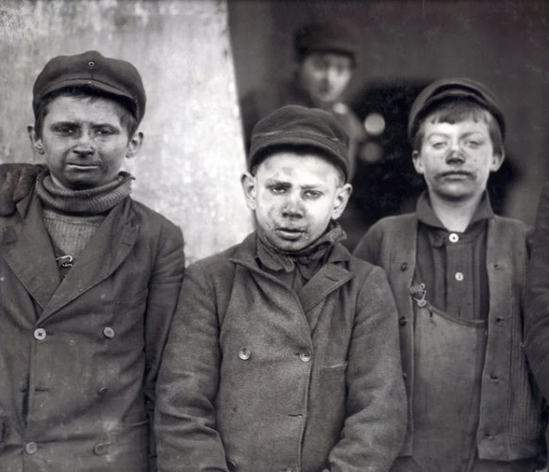
Child labor was restricted by the Fair Labor Standards Act

Slide 11
Child labor was restricted by the Fair Labor Standards Act
1938

Slide 12
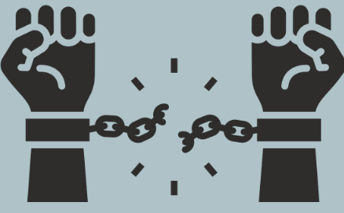
Slavery was outlawed by the 13th Amendment

Slide 13
Slavery was outlawed by the 13th Amendment
1865

Slide 14

Miranda Rights established by Supreme Court ruling (Miranda v. Arizona), requiring police to inform people of their rights during arrest

Slide 15
Miranda Rights established by Supreme Court ruling (Miranda v. Arizona), requiring police to inform people of their rights during arrest
1966

Slide 16
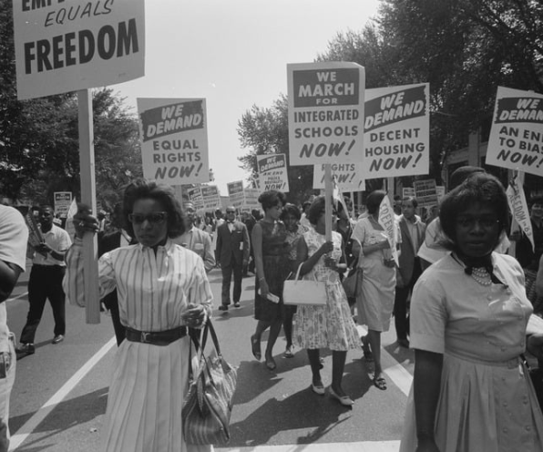
The Civil Rights Act banned discrimination based on race, color, religion, sex, or national origin

Slide 17
The Civil Rights Act banned discrimination based on race, color, religion, sex, or national origin
1964

Slide 18

Same-sex marriage legalized nationwide (Obergefell v. Hodges)

Slide 19
Same-sex marriage legalized nationwide (Obergefell v. Hodges)
2015

Slide 20

Due process rights (fair treatment in the justice system) strengthened by the 14th Amendment

Slide 21
Due process rights (fair treatment in the justice system) strengthened by the 14th Amendment
1868

Slide 22

Freedom of religion was guaranteed by the 1st Amendment

Slide 23
Freedom of religion was guaranteed by the 1st Amendment
1791

Slide 24

The Voting Rights Act helped protect voting access for minorities

Slide 25
The Voting Rights Act helped protect voting access for minorities
1965

Slide 26

The Affordable Care Act expanded healthcare access and patient protections

Slide 27
The Affordable Care Act expanded healthcare access and patient protections
2010

Slide 28

Workers gained safer working conditions with OSHA (Occupational Safety and Health Act)

Slide 29
Workers gained safer working conditions with OSHA (Occupational Safety and Health Act)
1970

Slide 30
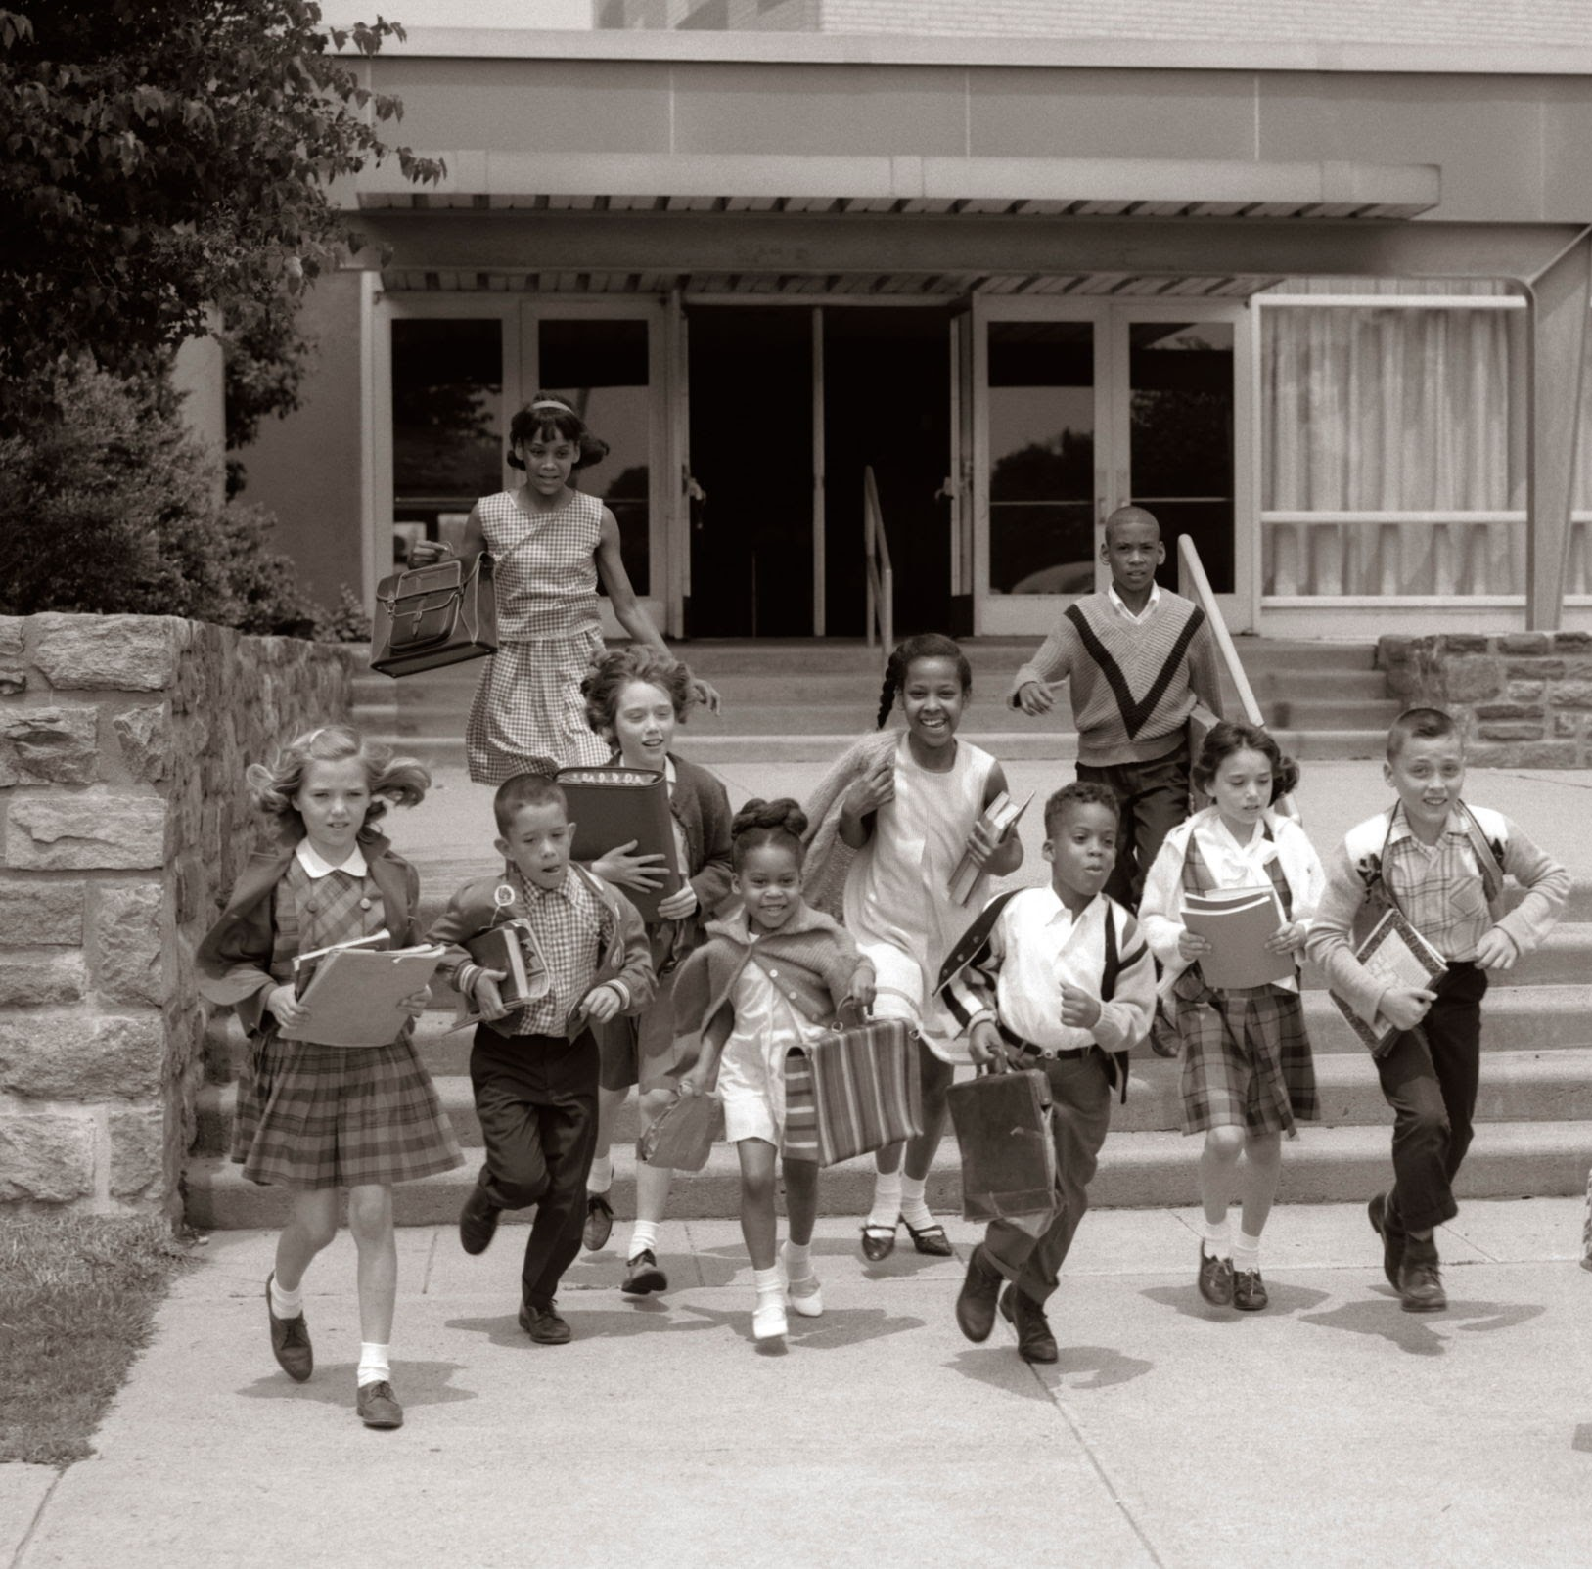
Brown v. Board of Education ended legal segregation in public schools

Slide 31
Brown v. Board of Education ended legal segregation in public schools
1954

Slide 32

The 15th Amendment granted African American men the right to vote

Slide 33
The 15th Amendment granted African American men the right to vote
1870

Slide 34

Freedom of speech was protected by the 1st Amendment

Slide 35
Freedom of speech was protected by the 1st Amendment
1791

Slide 36
Evolution of a Law/Right
Pick a law or right that has evolved significantly since 1776. Create a slideshow presentation explaining:
how the law/right has evolved
the impact it has had on American society

Slide 37
Evolution of a Law/Right
Slideshow should be 5-10 slides
Information should be written in your own words (do not copy/paste or use AI)
Keep track of the websites you use during your research and include them on a works cited slide at the end

