Slide 1
When I see this sign I should ___ ___ ___ ___ ! I can __ __when I have looked both ways and it is clear. I can go if the light turns __ __ __ __ __ and I have looked both ways.

Slide 2

When I see these signs I should S T O P!
(ARS 28-644 Stop for traffic lights and stop signs)
I can g o when I have looked both ways and it is clear. I can go if the light turned g r e e n and I have looked both ways.

Slide 3
When I see this sign I should ___ ___ ___ ___ ___ ! I can go when sidewalks, crosswalks and traffic has passed.

Slide 4
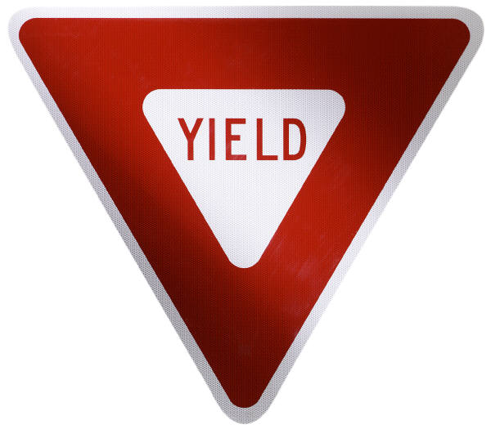
When I see this sign I should Y I E L D ! I can go when sidewalks, crosswalks and traffic has passed.

Slide 5
When I see these signs I should __ __ __ __ __ __ this direction only!

Slide 6
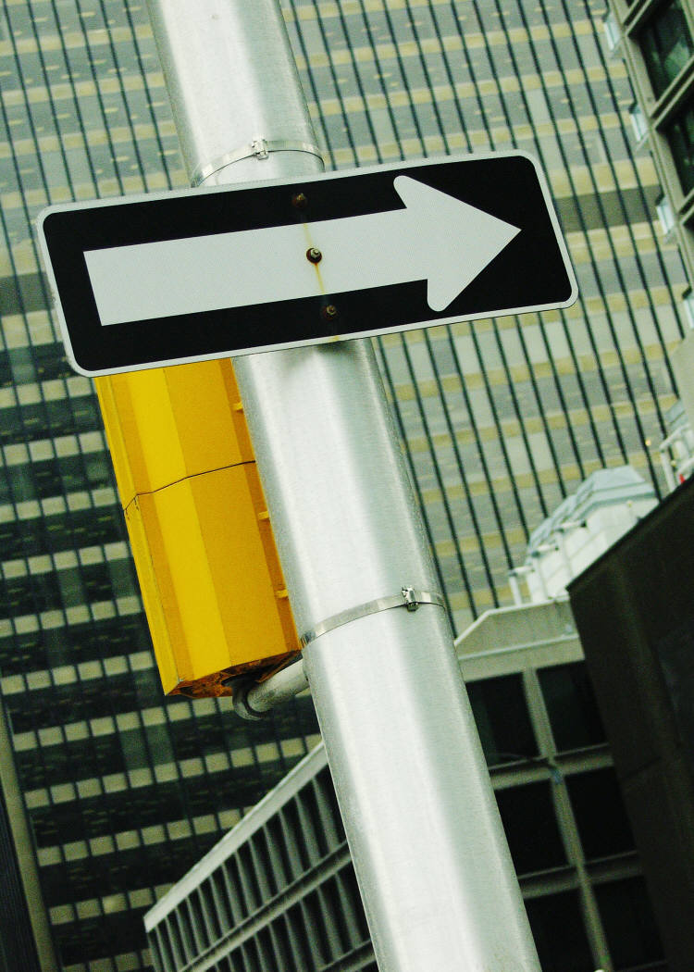
When I see these signs I should F O L L O W this direction only!

Slide 7
When I see these signs I should __ __ __ __ __ __ __ __ or go that direction! It is the __ __ __ __ __ __ __ __ !

Slide 8
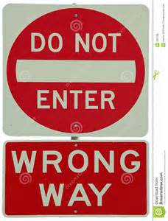
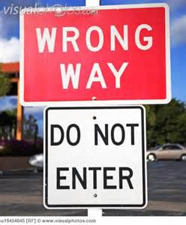
When I see these signs I should N O T E N T E R or go that direction! It is the W R O N G W A Y !

Slide 9
Missing Word List
DO NOT ENTER
FOLLOW
GO
GREEN
NOT ENTER
ONE WAY
STOP
WRONG WAY
YIELD
Missing Word List
DO NOT ENTER
FOLLOW
GO
GREEN
NOT ENTER
ONE WAY
STOP
WRONG WAY
YIELD
Missing Word List
DO NOT ENTER
FOLLOW
GO
GREEN
NOT ENTER
ONE WAY
STOP
WRONG WAY
YIELD
Missing Word List
DO NOT ENTER
FOLLOW
GO
GREEN
NOT ENTER
ONE WAY
STOP
WRONG WAY
YIELD
Missing Word List
DO NOT ENTER
FOLLOW
GO
GREEN
NOT ENTER
ONE WAY
STOP
WRONG WAY
YIELD
FOLLOW
GO
GREEN
NOT ENTER
STOP
WRONG WAY
YIELD
Missing Word List
DO NOT ENTER
FOLLOW
GO
GREEN
NOT ENTER
ONE WAY
STOP
WRONG WAY
YIELD

