Slide 1
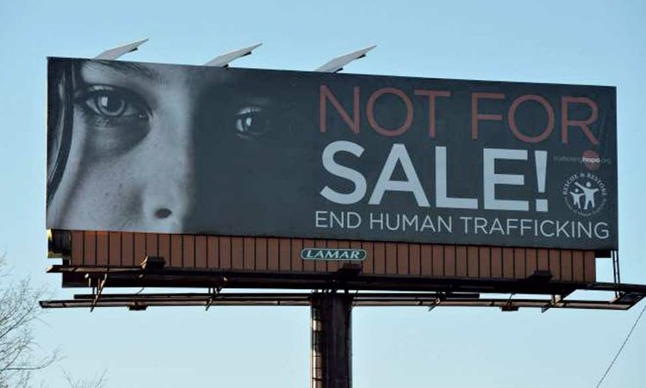
Billboards

Slide 2

Posters

Slide 3
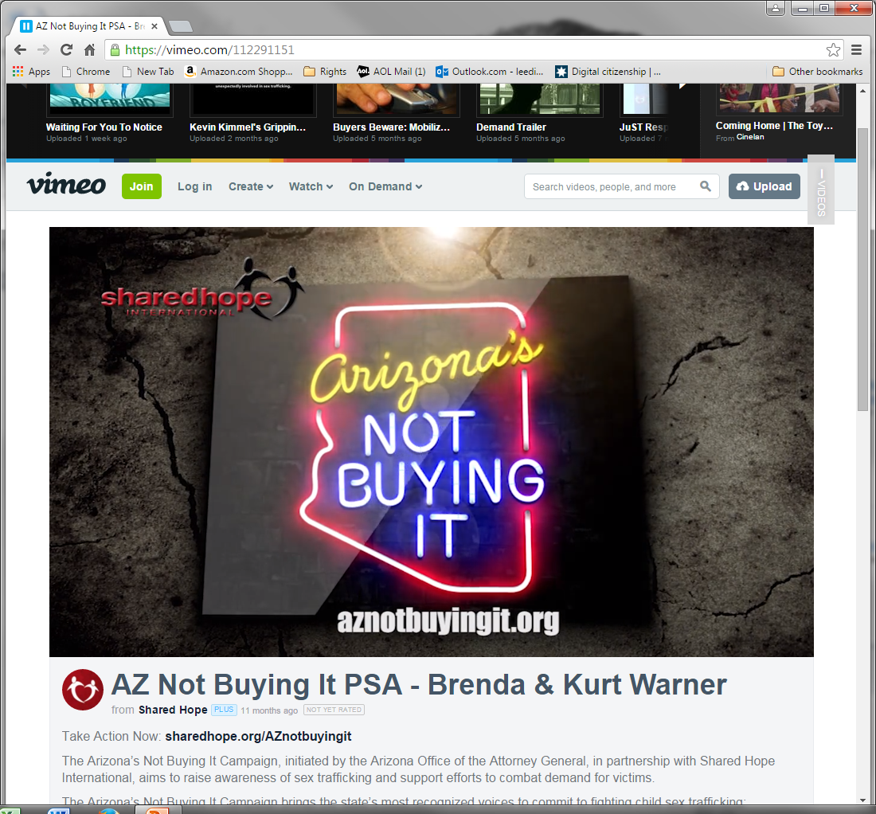
Public Service Announcements

Slide 4

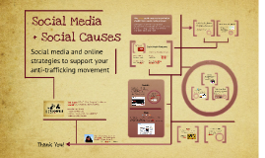
Social Media

