Slide 1
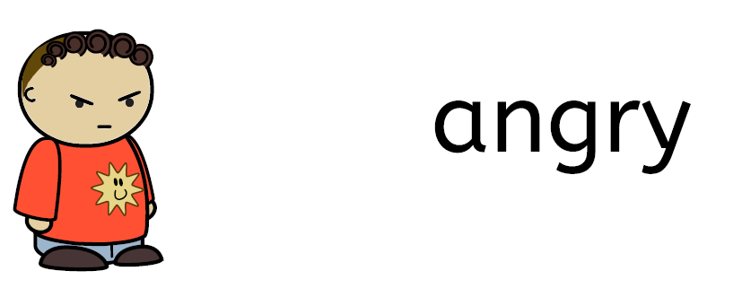

Slide 2


Slide 3


Slide 4


Slide 5

smile

Slide 6

breathe

Slide 7
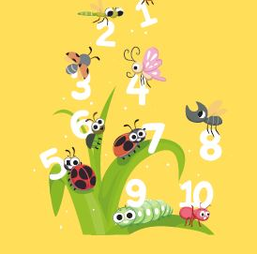
count

Slide 8
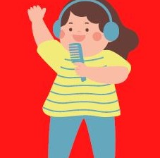
sing

Slide 9
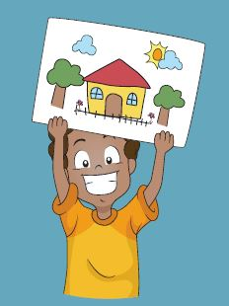
draw

Slide 10
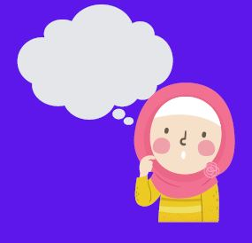
tell

