Slide 1

A ____________is a disagreement between two people.
solution
conflict
A ____________is a way to settle the disagreement so both people are okay.

Slide 2
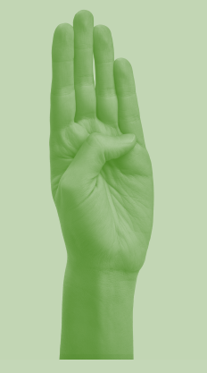
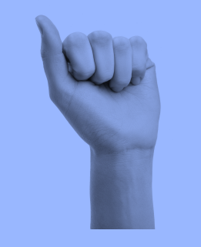
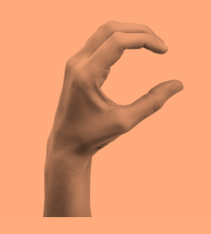

Slide 3
Scenario #1
Amy and Michael arrive home from school and run into the kitchen to be the first to tell their mom about their good grades. Amy got a check mark for completing all her math problems correctly and Michael got a gold star for writing neatly in his journal. They both try to push past each other and try to yell over the other one’s voice.
What is the best way to solve this conflict?
Take turns, the oldest can go first today.
They both can talk at the same time.
Neither one can share their success.
Is there another way to solve the conflict so both are okay?

Slide 4
Scenario #2
John and Sam are playing kickball during school recess. After the game they go to the bench to get a drink from their water bottle. They both reach for the same bottle and begin arguing over who it belongs to.
What is the best way to solve this conflict?
Look and see if they can find the other water bottle to determine whose water bottle this one belongs to.
They both can get a new water bottle from the teacher.
Neither one gets a drink.
Is there another way to solve the conflict so they are both okay?

Slide 5
Scenario #3
Amali and Tanisha run to the reading circle and both pick the purple square to sit on at the same time. “Only one student per square”, says the teacher. Both girls refuse to move.
What is the best way to solve this conflict?
The shortest student can have the purple square today.
They can take turns and the tallest student can sit there first and then they can switch after the story.
Neither one gets to sit on the purple square.
Is there another way to solve this conflict so they are both okay?

